Slide 1

Digital Transformation in the Manufacturing Plant
Predictive Maintenance with IOT
Nadia Hernandez-Quan
Data & AI Solutions Specialist

Slide 2

Contents
Overview
Predictive Maintenance
Use Cases
Data Foundation
Modeling
Modeling Example
Physics of Failure
Key Measurements
Intelligence

Slide 3
































…empowering individuals and organizations… That's our identity.”
Satya Nadella CEO, Microsoft Corp

Slide 4


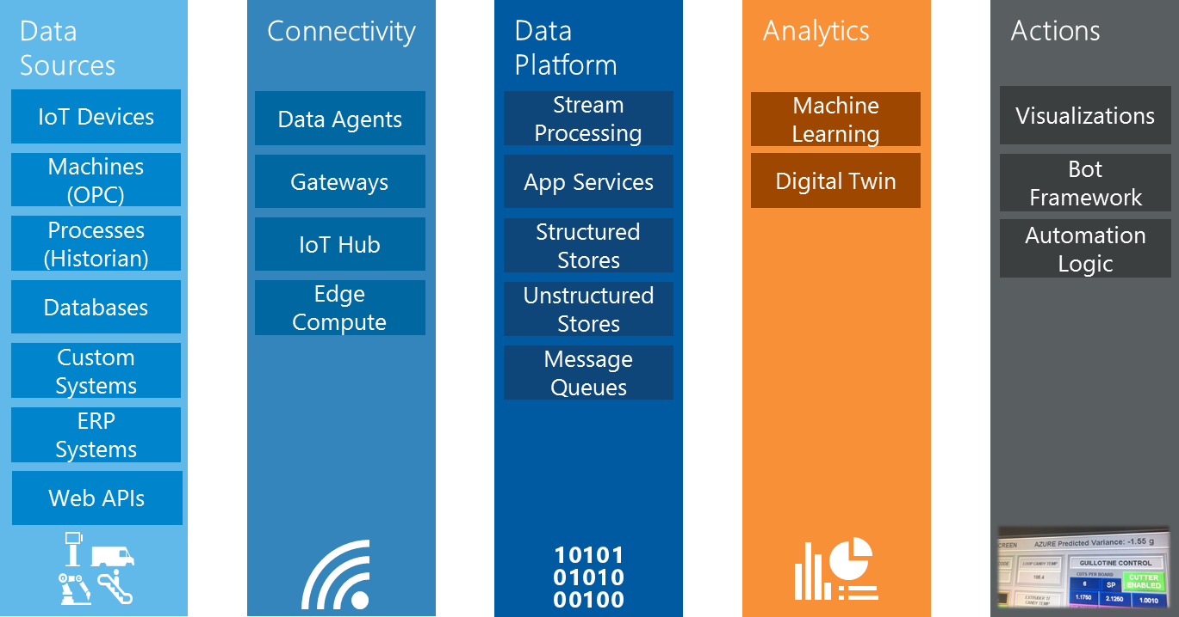


The Business Case & Long Term Vision
Quick Win
Direction
Digital Innovation Pillars

Slide 5
Realizing vision for iot
Value Categories
Value Levers
Product as a Platform
Net New Revenue Sources
NextGen Products/Services
Most Valuable Information Provider
New Business and Operating Models
IoT Value Proposition
Operations and Predictive Maintenance
Product & Service
Optimization
Commercial Optimization
Customer Experience and Applications
Preventive Maintenance
Operational Efficiency
Process Automation
Operation Optimization
Global Asset Visibility
5

Slide 6
Contents
Industry Overview
Predictive Maintenance
Use Cases
Data Foundation
Modeling
Modeling Example
Physics of Failure
Key Measurements
Intelligence

Slide 7


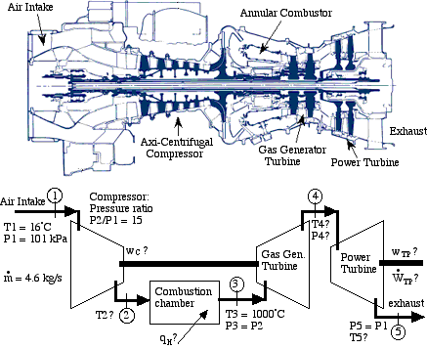
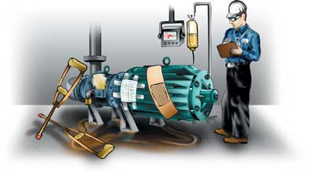
Predictive Maintenance
The four facets of Predictive Maintenance:
Detect Failures Where are there failures now?
Diagnose Failures What part(s) are failing?
Explain Failures Why are they failing?
Predict Failures! When will it fail?

Slide 8

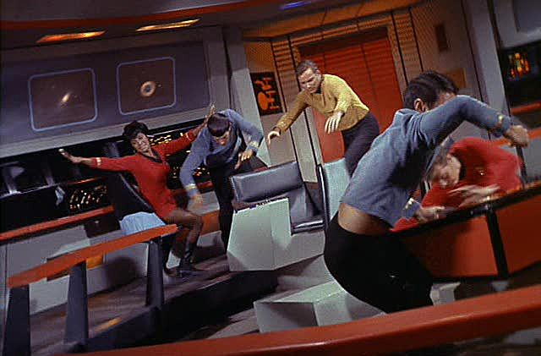


Predictive Maintenance is here now
Did you hear that [grinding, whining, clanking, …] sound?
Do you feel that vibration?
Does this feel [warm, hot, cold] to you?
Check Engine.
Check Engine Now!!

Slide 9
Contents
Industry Overview
Predictive Maintenance
Use Cases
Data Foundation
Modeling
Modeling Example
Physics of Failure
Key Measurements
Intelligence

Slide 10


Predictive Maintenance Use Cases
Aerospace
Utilities
Manufacturing
Transportation & Logistics
What is the likelihood of delay due to mechanical issues?
When is my solar panel or wind turbine going to fail next?
Will the component pass next stage of testing on factory floor?
Should I replace the brake discs in my car or can I wait for another month?
When is this aircraft component likely to fail next?
Which circuit breakers in my system are likely to fail in the next month?
What is the root cause of the test failure?
What maintenance task should I perform on my elevator?
Is the ATM going to dispense the next 5 notes without failing?
Is a turbine about to overspeed and explode?

Slide 11













PREDICTIVE MAINTENANCE SCENARIOS
Address business needs across a range of scenarios…
Optimize uptime and extend equipment life expectancy to improve product quality
Improve product design and services with increased cost savings
Enhance customer engagement with contextual and responsive services
Enable development of innovative and differentiated business models
MAINTENANCE INITIATED
ADD BEST PRACTICE
43.1° | 35.2°
91.6° | 87.3°
Gain visibility into product performance and enable workflows to respond to changing conditions.
Utilize service and performance data to proactively detect product failure.
Offer predictive and proactive services to address customer and product needs.
Identify trends and potential growth opportunities using customer sentiment and product usage data.

Slide 12
Contents
Industry Overview
Predictive Maintenance
Use Cases
Data Foundation
Modeling
Modeling Example
Physics of Failure
Key Measurements
Intelligence

Slide 13
PREDICTIVE MAINTENANCE FRAMEWORK IN CONTEXT
2
Inventory data sources
Identify all potential sources of data, including the types of data and the amounts available. The outcome you are seeking will influence what data is essential and what’s optional.
Weather data
Failure logs
Include data from a variety of sources – you may be surprised about the places where key information can come from.
100101011000
101000101101
010011001110
101000110011
Performance
data
Sensor data
Maintenance logs

Slide 14
The raw materials of Data Science
Data is relevant
Data is accurate
Data is connected.
Data is big enough.
Data is modeled.
E.g. vibration, temperature, oil debris
E.g. acoustic data mostly free of noise
E.g. telemetry uploaded in real-time and linked to maintenance records
E.g. the more data, the more accuracy and precision
E.g. prior knowledge from domain experts is adds decades of data and learning

Slide 15
Data Sources
FAILURE HISTORY
REPAIR HISTORY
MACHINE CONDITIONS
The failure history of a machine or component within the machine.
The repair history of a machine, previous maintenance records, components replaced, maintenance activities performed.
The operation conditions of a machine, e.g. data collected from sensors.
MACHINE FEATURES
OPERATING CONDITIONS
OPERATOR ATTRIBUTES
The features of machine or components, e.g. production date, technical specifications.
Environmental features that may influence a machine’s performance, e.g. location, temperature, other interactions.
The attributes of the operator who uses the machine, e.g. driver.

Slide 16
Contents
Industry Overview
Predictive Maintenance
Use Cases
Data Foundation
Modeling
Modeling Example
Physics of Failure
Key Measurements
Intelligence

Slide 17
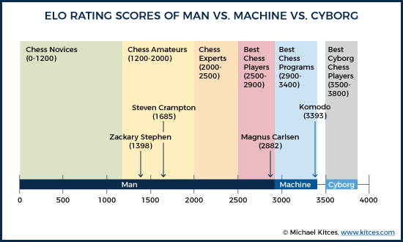
Machine Learning is Human Guided
Chess is well-defined simple game with 1500 year recorded history, millions of recorded games, and 50 years of computer science research into chess AI and yet:
Cyborgs beat the best computers 65% to 85% of the time.

Slide 18
Modeling Problems
BINARY CLASSIFICATION
REGRESSION
Predict failures within a future period of time
Predict remaining useful life, the amount of time before the next failure
MULTICLASS CLASSIFICATION
ANOMALY DETECTION
Predict failures with their causes within a future time period.
Predict remaining useful life within ranges of future periods
Identify change in normal trends to find anomalies

Slide 19
Contents
Industry Overview
Predictive Maintenance
Use Cases
Data Foundation
Modeling
Modeling Example
Physics of Failure
Key Measurements
Intelligence

Slide 20
Goal: to predict chiller load from outside air temperature, wet bulb temperature, and humidity.
(For visualization convenience in this presentation predicted values are displayed in 2D either versus a variable of interest. In all cases, the R-squared value accounts for all predictors ie the complete model).
Load Prediction Begins

Slide 21
Clearly load does correlated with the predictors. However, only 47% of the variation is explained by a simple linear the model. Can we do better?
This data is the chiller load for a commercial building. Perhaps it has a workforce contributing internal heat generation (body heat) on some daily schedule.
Hypothesis: Workforce body heat is contributing to chiller load. The workforce probably fluctuates throughout the week on a regular schedule.
Model: Create a latent heat variable for each 7x24 hour of the week. Infer the latent heat generation from the data. Use Azure Machine Learning Studio
Load Prediction Think

Slide 22
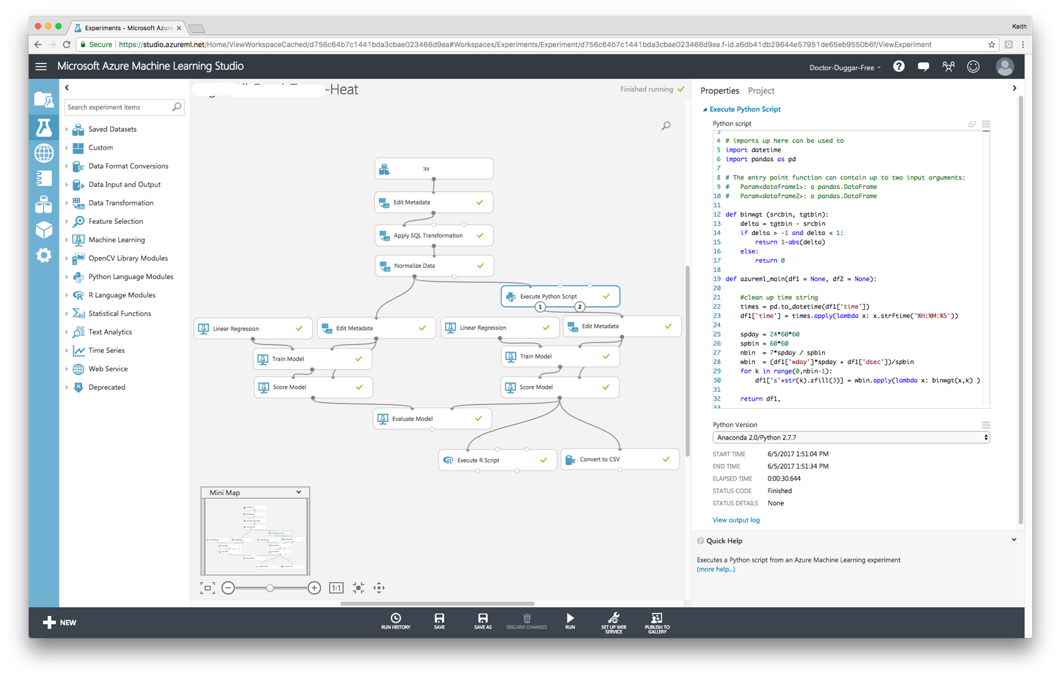
Load Prediction Azure ML

Slide 23
Sunday
Monday
Tuesday
Wednesday
Thursday
Friday
Saturday
Load Prediction Observe

Slide 24
Workforce heat generation is clearly identifiable. The correlation with workday and work hours (dotted red lines are 8am and 4pm) is evident. Rules out solar phenomenon as Saturday and Sunday clearly different.
Load Prediction
Prediction has improved from 47% to 62% R-squared. Not bad for only a single building for a single year!

Slide 25
Contents
Industry Overview
Predictive Maintenance
Use Cases
Data Foundation
Modeling
Modeling Example
Physics of Failure
Key Measurements
Intelligence

Slide 26
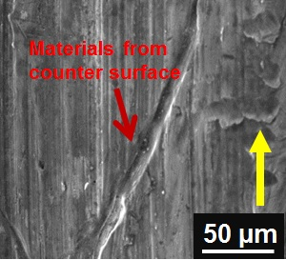
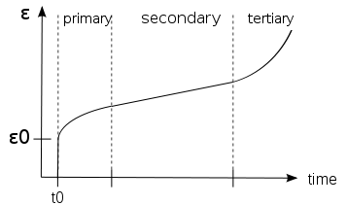
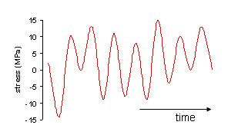
Physics of Failure
The three modes of physical failure:
Creep – deformation by stress, temperature
Fatigue – cracking by cyclic load
Wear – material removal by shearing contact

Slide 27
Contents
Industry Overview
Predictive Maintenance
Use Cases
Data Foundation
Modeling
Modeling Example
Physics of Failure
Key Measurements
Intelligence

Slide 28
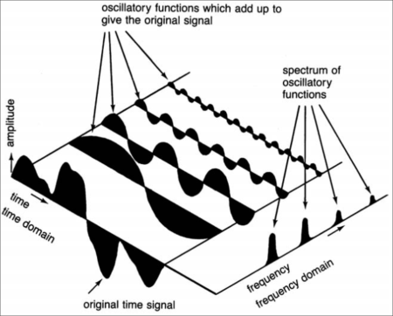
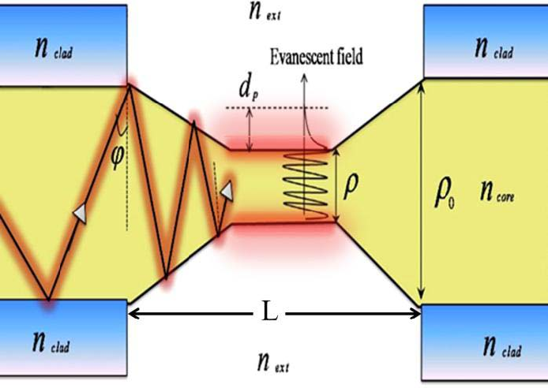
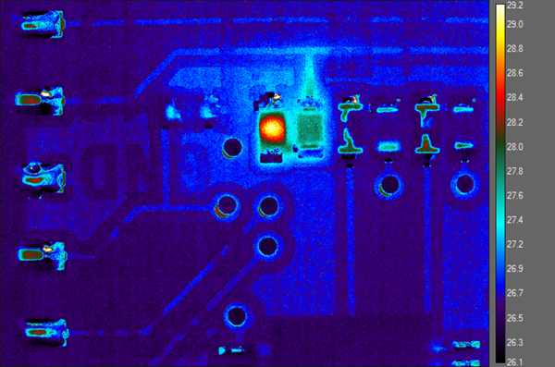
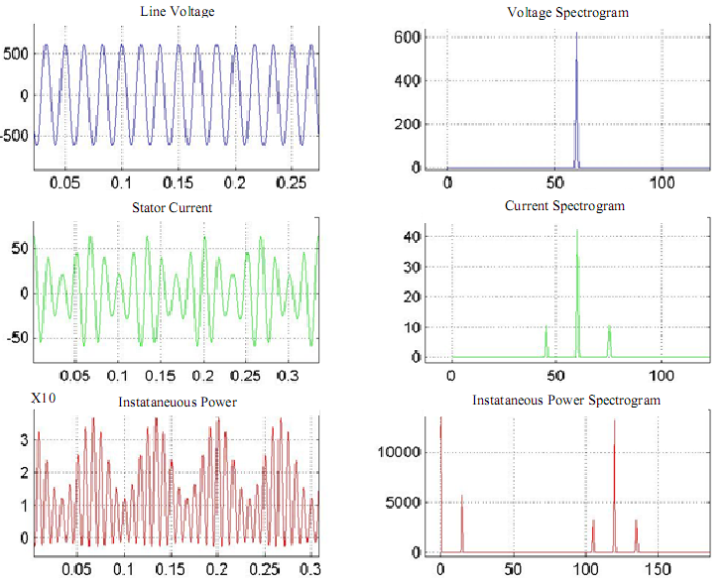
What to measure?
Vibration : accelerometer, piezo-eletric
Acoustic : attached microphone
Acoustic Noise : detached microphone
Oil Quality : turbidimeter, spectrophotometer, …
Temperatures : localized thermocouple
Pressures : proxies for stress
Motor Electrical Signature : high-frequency voltmeter + ammeter

Slide 29
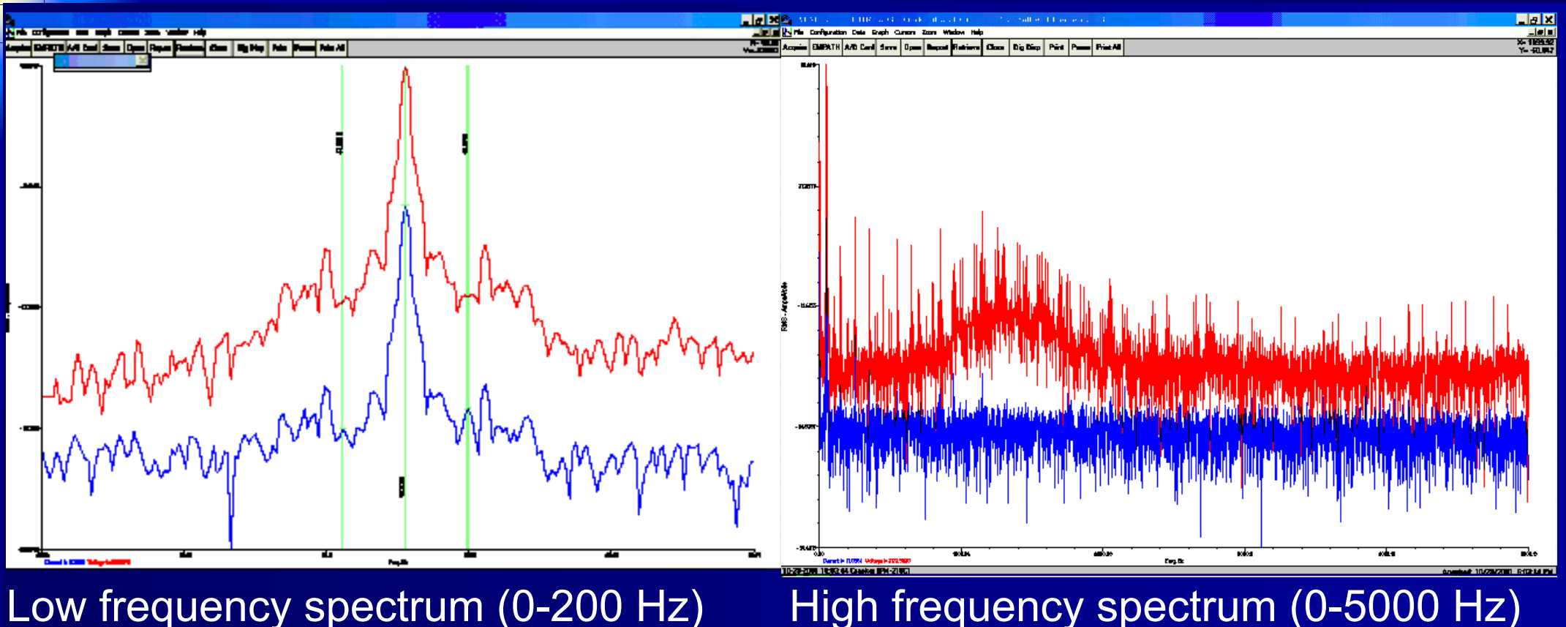
MOTOR ELECTRICAL SIGNATURE
Normal Signature

Slide 30
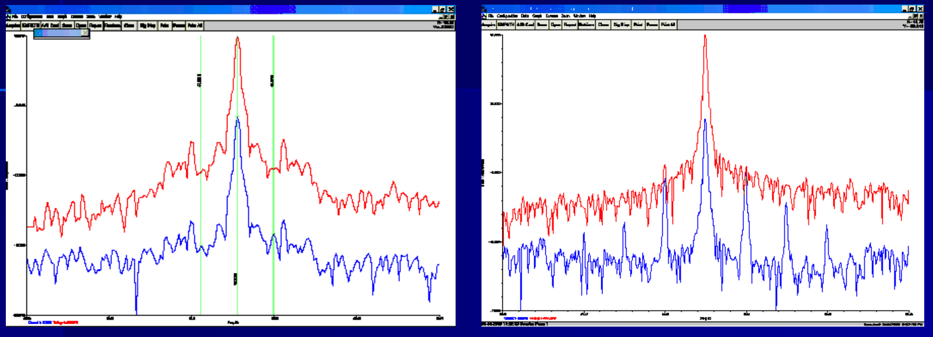
MOTOR ELECTRICAL SIGNATURE
Normal Signature
Rotor Bar Damage

Slide 31
Contents
Industry Overview
Predictive Maintenance
Use Cases
Data Foundation
Modeling
Modeling Example
Physics of Failure
Key Measurements
Intelligence

Slide 32
The components of an intelligent system
Sensors – Data Capture
Linking – Data Integration
Science – Knowledge
Control – Action
DATA
TRUST
FEEDBACK
Sensors – Instrumentation, who are your partners?
Linking – How is IT working with the business?
Science – Can your front line workers do their job better with this solution?
Control – Who are your risk owners and how can they be empowered to act?

Slide 33


The Bet, The buy-In, & The Vision

